Slide 1
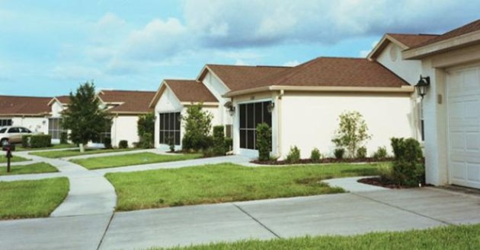
Analyzing and predicting the Housing Market
Jo Mataparthi

Slide 2
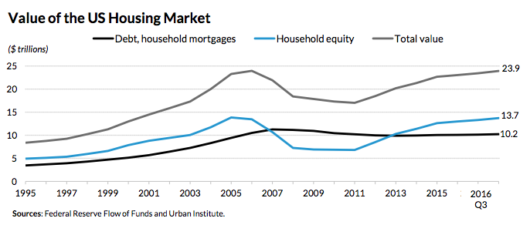
Motivation
$24 Trillion US Dollars and the only practical alternative to stocks
Notes:
3 points: market size, alternative to stocks and leverage

Slide 3

Agenda
Introduction
Visualizations
Modeling
Conclusion

Slide 4
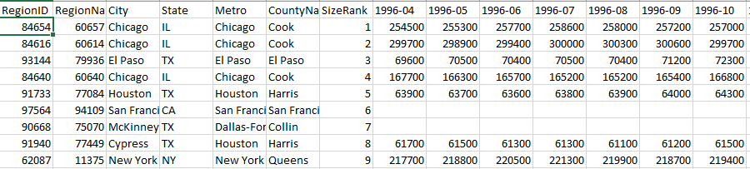
Zillow data
Introduction
Visualizations
Modeling
Conclusion
Home prices and rents of all nearly 15,000 zip codes since 1996 and 2010 respectively

Slide 5
Analysis plan
Introduction
Introduction
Visualizations
Visualizations
Modeling
Modeling
Conclusion
Conclusion
Business understanding of the project
Join, Calculate home value/rent for all house types, location
Brainstorm predictors and search for relevant data or proxy data
Analyze % of null values, descriptive statistics
Create visualizations to understand the data
Model the appropriate relationship

Slide 6

Strategy
Introduction
Introduction
Visualizations
Visualizations
Modeling
Modeling
Conclusion
Conclusion
Diff btw Rent and mortgage
Growth in rental income
Profit
Growth in home value

Slide 7
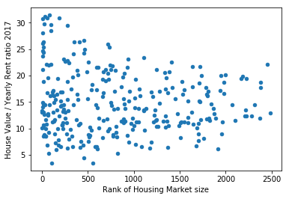
Big markets may be cheap
Introduction
Introduction
Visualizations
Visualizations
Modeling
Modeling
Conclusion
Conclusion

Slide 8
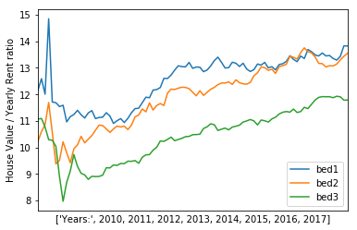
3 Bed homes cheaper
Introduction
Introduction
Introduction
Visualizations
Visualizations
Visualizations
Modeling
Modeling
Modeling
Conclusion
Conclusion
Conclusion

Slide 9
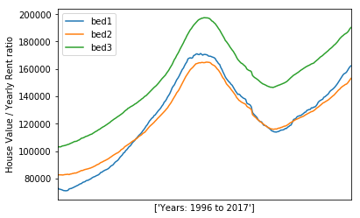
Home type may not matter
Introduction
Introduction
Introduction
Visualizations
Visualizations
Visualizations
Modeling
Modeling
Modeling
Conclusion
Conclusion
Conclusion

Slide 10
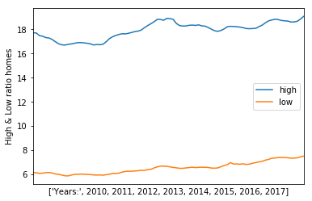
No reversion to mean
Introduction
Introduction
Introduction
Visualizations
Visualizations
Visualizations
Modeling
Modeling
Modeling
Conclusion
Conclusion
Conclusion

Slide 11
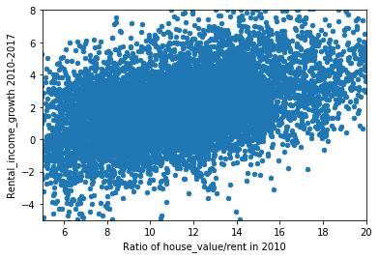
High Ratio = High Growth
Introduction
Introduction
Introduction
Visualizations
Visualizations
Visualizations
Modeling
Modeling
Modeling
Conclusion
Conclusion
Conclusion
Notes:
2 things to note: High ratio means high expectations for people
Notice that rent decreased in 25% of the zip codes since 2010

Slide 12
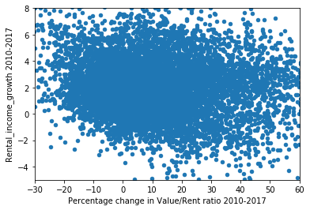
Cheap markets stay cheap
Introduction
Introduction
Introduction
Visualizations
Visualizations
Visualizations
Modeling
Modeling
Modeling
Conclusion
Conclusion
Conclusion

Slide 13
Factors affecting House Prices
Introduction
Introduction
Visualizations
Visualizations
Modeling
Modeling
Conclusion
Conclusion
Interest rates
Economic growth
Migration
Unemployment levels
Post tax income - minimum of Rent or Mortgage
Minimum of Rent of Mortgage/ Post tax income ratio
Quality of life in the zip code (income level)
Wealth of the local residents
Percentage of residents in 23 - 33 age group
Current and past percentage of Rentals vs Ownership
Overall population turnover % in the zip code

Slide 14
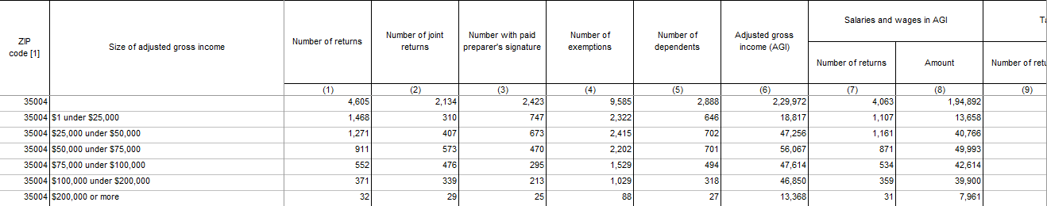
IRS data
Introduction
Introduction
Introduction
Visualizations
Visualizations
Visualizations
Modeling
Modeling
Modeling
Conclusion
Conclusion
Conclusion
Wrangling, feature extraction with the IRS tax data set
Median Income of zip code
Adjusted Median Income of zip (> 100,000 counts as 100,000)
Percentage of population by income bracket
Capital Gains per individual
Percentage of singles
Percentage of home ownership ratio

Slide 15

Modeling the relationship
Introduction
Introduction
Introduction
Visualizations
Visualizations
Visualizations
Modeling
Modeling
Modeling
Conclusion
Conclusion
Conclusion
150,000 rows, 8000 zip codes, 17 years
Response variable: House price percentage change from current year Jan to next year Jan
Predictors
County level unemployment rate (January)
Mortgage rate
State GDP change in the last year
Current House value / rent ratio (January)
Notes:
Why I am predicting change and not value: to avoid time series
Why am I not doing cross validation? Because year matters. You can’t predict past with future

Slide 16
Modeling results
Introduction
Introduction
Introduction
Visualizations
Visualizations
Visualizations
Modeling
Modeling
Modeling
Conclusion
Conclusion
Conclusion
Modeling approach | RMSE | Comments
Linear Regression | 7 | Testing period from 2010
Random Forest regression | 9.9 | 100 trees, Testing period from 2010
Support Vector Regression | 7.7 | C = 0.1. Randomly sampled 10,000 rows. Testing period from 2010

Slide 17
Results discussion
Introduction
Introduction
Introduction
Visualizations
Visualizations
Visualizations
Modeling
Modeling
Modeling
Conclusion
Conclusion
Conclusion
Generate relevant visualizations and descriptive statistics
Do the analysis for 2010 - 2017 with actual value_ratios
Restrict analysis to markets with ratios in the range of 5 to 20
Restrict the analysis only for ratio below 7
Predict yearly house_price_change adjusted for median_house_price_change
Change prediction window to 5 years
Features that are more change from previous year oriented rather than actual values
Build separate models for rents and prices
Rents may be actually dependant on zip code level specific data. House values are dependant on the rent and the ratio. The ratio depends on the economy. Hard to predict economy, recessions
Not many transactions on Zillow in 2010. Data quality concerns. Need better and zip code level predictors

Slide 18
Summary
Introduction
Introduction
Visualizations
Visualizations
Modeling
Modeling
Conclusion
Conclusion
Lower House value to rent ratio indicates better investment opportunity
Type of the house may not be very important
Need to experiment with multiple modeling approaches to better predict rent and house value
Cash flow and profit can be projected with a model to identify the best zip codes for investment

Slide 19
References
Introduction
Introduction
Introduction
Visualizations
Visualizations
Visualizations
Modeling
Modeling
Modeling
Conclusion
Conclusion
Conclusion
[1] Housing Market value
http://realtybiznews.com/total-value-u-s-housing-market-hits-23-9-trillion/98736694/
[2] Zillow Price, Rent, Ratio data across zip codes https://www.zillow.com/research/data/
[3] County level unemployment data https://www.kaggle.com/jayrav13/unemployment-by-county-us
[4] State level GDP data https://www.bea.gov/itable/iTable.cfm?ReqID=70&step=1#reqid=70&step=1&isuri=1
[5] 30 year Mortgage rates https://fred.stlouisfed.org/series/MORTGAGE30US
[6] IRS income tax data https://www.irs.gov/statistics/soi-tax-stats-individual-income-tax-statistics-zip-code-data-soi

